Slide 1
Data Model Schemas for Productivity Metrics

Slide 2

Notes:
Management reporting packages need a reliable foundation
https://goldenbayfoundationbuilders.com/concrete-block-foundation-detail/

Slide 3

Notes:
For capturing user productivity data
https://medium.com/@rethinkyourunderstanding/unlocking-the-value-of-software-delivery-difficulty-of-reporting-on-value-cdd512dd48cf

Slide 4

Notes:
Flat files often introduce data integrity errors
https://www.dataversity.net/articles/common-data-integrity-issues-and-how-to-overcome-them/

Slide 5

Notes:
And multi-user concurrency issues
https://thumbs.dreamstime.com/b/tug-war-alert-full-length-shot-two-young-children-fighting-over-teddy-bear-playing-home-277266653.jpg

Slide 6

Notes:
Transactional databases replace error-prone spreadsheets
https://webapp.io/blog/content/images/size/w2000/2019/11/postgres.png

Slide 7

Notes:
We begin with normalization
https://blog.saleslayer.com/hubfs/A_Blog/2019-11-November/database-normalization.jpeg

Slide 8
There can only be…3?
Notes:
To the third Normal Form

Slide 9
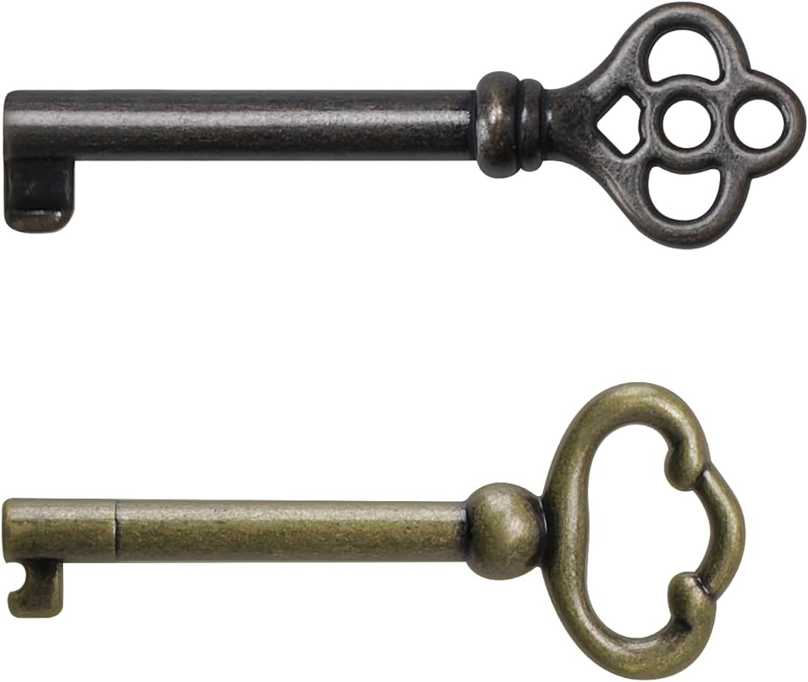
Notes:
Primary and foreign key constraints

Slide 10

Notes:
Prevent orphaned entries
https://i.pinimg.com/736x/01/8e/d5/018ed5ca6b82069e9a60890025204e18.jpg

Slide 11

Notes:
Foreign Keys lock entries to users
https://fontawesome.com/icons/classic/solid/user-lock

Slide 12

Business Rule
Notes:
Check constraints enforce business rules at the database level
https://assets3.thrillist.com/v1/image/1655936/1200x600/scale;;webp=auto;jpeg_quality=85.jpg

Slide 13

Notes:
Domain rules automatically sanitize inputs at the point of entry
https://corvusjanitorial.com/wp-content/uploads/2021/01/Janitor.jpg

Slide 14

Notes:
Strong data types ensure things like task count accepts only integers
https://www.tupperware.com/cdn/shop/files/10187478000.jpg?v=1780593944&width=1445

Slide 15

Time Stamps
Notes:
Default values and timestamps are added a row insertion for auditing

Slide 16

Notes:
Audit tracking maintains reliable data quality
https://naturalareasnyc.org/wp-content/uploads/2026/01/Animal-tracks-blog-post.png

Slide 17
BUT WAIT!
Notes:
That’s how the data will be stored.

Slide 18

Notes:
How do we communicate it?
https://as2.ftcdn.net/v2/jpg/18/24/41/65/1000_F_1824416504_vqDVH6fRFBJDfjOsjjpbFBit7dRjDAkh.jpg

Slide 19
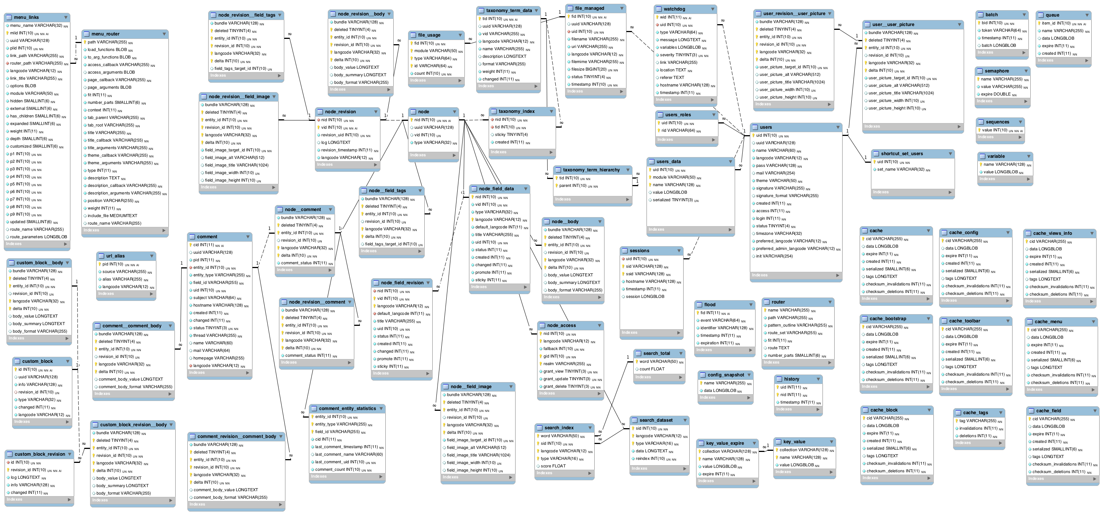
Notes:
OLTP databases are great for row-level inserts, update and ACID compliance, but management shouldn’t need a map to understand the dashboards
https://www.activequerybuilder.com/blog/content/images/2019/01/Drupal8_UPsitesWeb_Schema_10-19-2013.png

Slide 20

Notes:
Power BI needs read optimized structures
https://imgs.search.brave.com/6RFtvUKTckls7NT2ylOB324aCIwXfYd8IUwzhMTWutQ/rs:fit:860:0:0:0/g:ce/aHR0cHM6Ly9pcmlz/cmVhZGluZy1tZWRp/YS5zMy1hY2NlbGVy/YXRlLmFtYXpvbmF3/cy5jb20vMjAyMi8x/MS8yLmpwZw

Slide 21
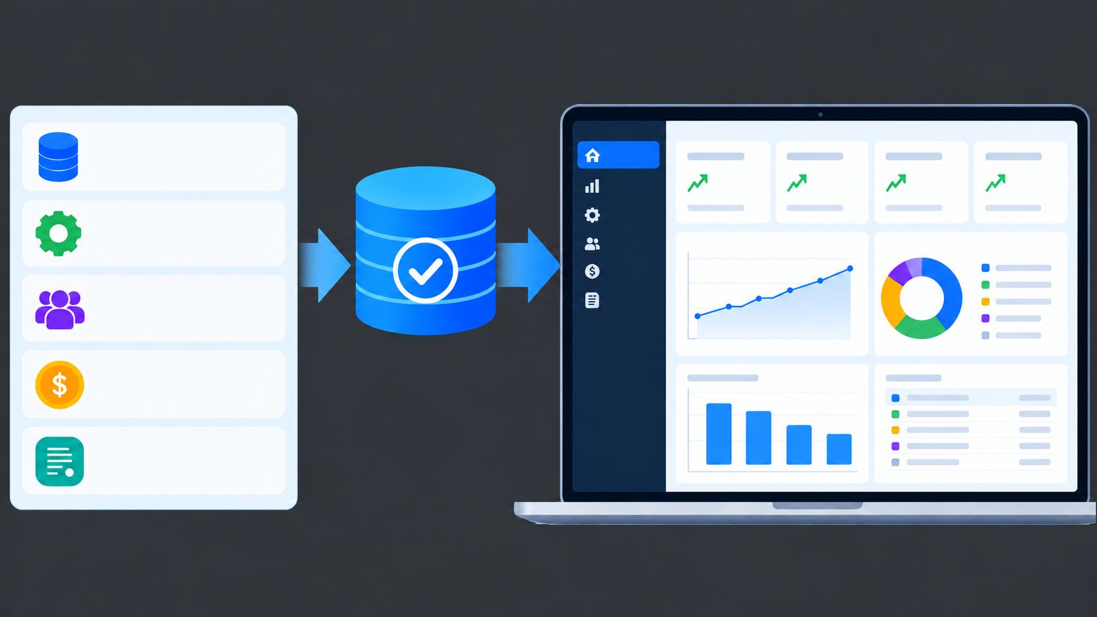
Notes:
To bridge this gap, we need to move clean operational data into a reporting model
blob:https://chatgpt.com/24a2615b-4283-4cb3-b243-26f96c213992

Slide 22

Notes:
Running dashboards off 3NF tables degrades query performance
https://imgs.search.brave.com/QmOhRbDd1icJnAJ5qETo91-zvre5vHuWQGg9NdBHOJc/rs:fit:860:0:0:0/g:ce/aHR0cHM6Ly9nZWVr/c29uc2l0ZS5jb20v/d3AtY29udGVudC91/cGxvYWRzLzIwMjYv/MDgvQXBwcy10aGF0/LXNsb3ctZG93bi1j/b21wdXRlci5qcGc

Slide 23

Notes:
And creates bottlenecks that we can solve
https://imgs.search.brave.com/Bb089PbgbSY9S_jJFZZ0OTwQ_BL5s0Ne5LVBLxTFPS4/rs:fit:500:0:1:0/g:ce/aHR0cHM6Ly90NC5m/dGNkbi5uZXQvanBn/LzAzLzE2Lzc5Lzk1/LzM2MF9GXzMxNjc5/OTU3Ml9KV2dqRmdF/aU1FSUZzMUV2b1NJ/OHdRZXBXczRSVjVZ/ZS5qcGc

Slide 24

Notes:
With the star schema modeling principles https://imgs.search.brave.com/F6tDV8sKW1CFRz5Lwf1higgvY_Z4X0LQmNL2rFxZTjY/rs:fit:860:0:0:0/g:ce/aHR0cHM6Ly9pLnBp/bmltZy5jb20vb3Jp/Z2luYWxzLzRkLzky/LzcwLzRkOTI3MDI2/ZDU4NTBiMjk5YmFj/ZTE0Y2VkYzIxNjlh/LmpwZw

Slide 25
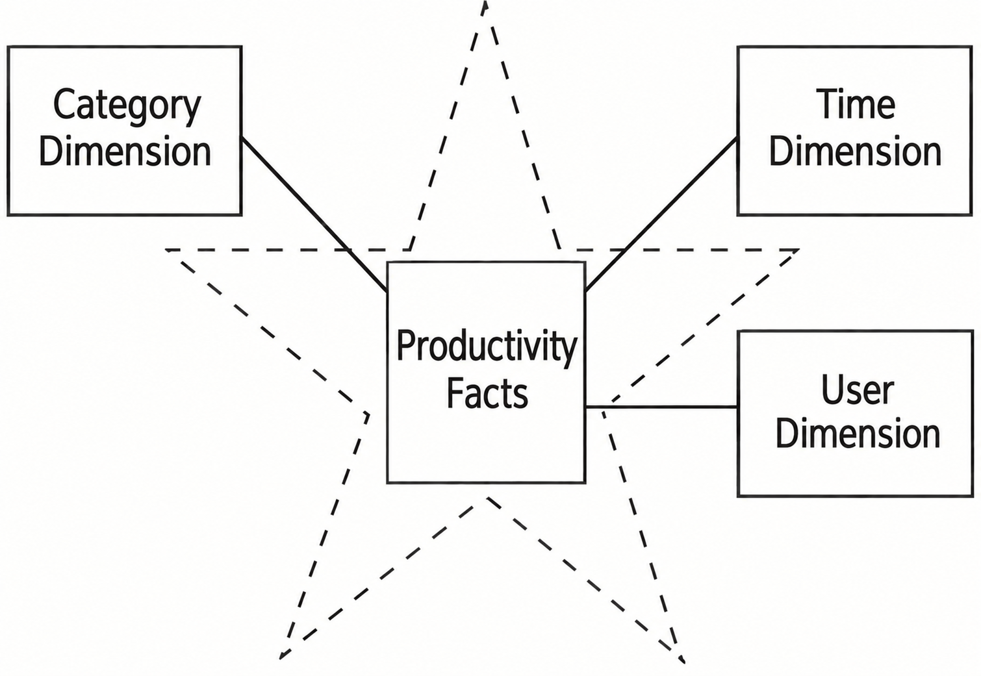
Notes:
We structure the schema around a central productivity fact table with the dimensions radiating out
Original image cropped from:
Database Systems: Concepts, Design and Applications, 2nd Edition https://learning.oreilly.com/library/view/database-systems-concepts/9788131760925/
Chatgpt used to modify graphic to what is presented
blob:https://chatgpt.com/2c52c8c0-980d-4719-9eb5-e5c22c28b7a3

Slide 26
Quantitative user metrics
Additive user metrics
Ie. Task completion count
Productivity facts =
Notes:
The Productivity Facts table captures

Slide 27
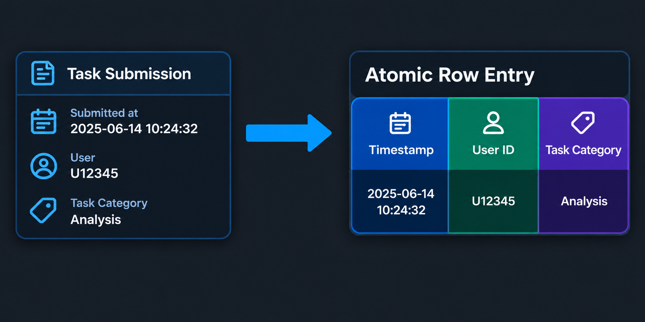
Notes:
Every submission then maps onto our schema with a timestamp, user ID, task category and region
Generated with ChatGPT
blob:https://chatgpt.com/a74e1a9e-d61e-4cab-9559-f14a2b10e1c7

